Slide 1
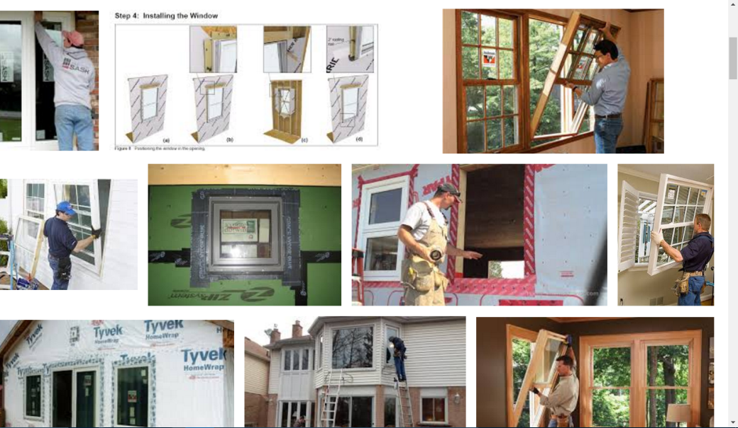

Sigma Nu Housing Corporation Capital Project
Window Replacement
At our 2016 Delta Chi Rho reunion one of the Sigma Nu actives remarked to one of the brothers that the fraternity house was cold and drafty and the utility bills were high. The remark fell on sympathetic ears resulting in an idea to start a fund raising project to help out the youngsters who have no idea how hot or cold that attic dormitory was back in the day before air conditioning and any form of heat in attic other than what the warm bodies were generating. Youngsters today for the most part have no clue what roughing it was like! Remember walking down 3rd Ave wagging a drafting board in one hand and a brief case full of text books in the other in sub-zero temperatures? Thanks N. Whitty for these words .
So here is a short 1570 Flushing Drive house quiz!!!!! Answers below
  How many window openings are there in this house?
  How many portal openings are in this house?
  How old is the oldest window in the house, and which location is it in?
  What is the monthly utility bill for HVAC for this house?
The co champions of the project are alum Tom Plotkowski and active Andrew Damiani
We have set a goal of $50,000 for this project and we will break the replacements down into $5000 blocks so we don't replace all the windows at once.
It is recommended that donations for each window be $500 - $1000
A plaque with the donors name will either be placed on each replacement window or on one big project plaque located in the founders room noting:
  Donated as a gift to "alumni"
  Donated by "alumni"
  Anonymous donation
  Donated in memory of "alumni“
All donations are to be sent to
  Sigma Nu Fraternity
  Care of Tom Plotkowski
  6544 Montgomery
  Shelby Township, Mi 48316
  Make check out to Sigma Nu Fraternity
  Please denote the notes section of the check, window fund and how you would like the donation to
  appear on the plaque.
50000
45000
40000
Status as of 2/1/17
35000
30000
25000
20000
15000
10000
5000
$
$1000 12/06/16
$500 12/13/16
$500 01/03/17
$500 01/12/17

